Slide 1



UNIT 1
LEARNING LIFE
COOL SUMMER, PART 3

Slide 2
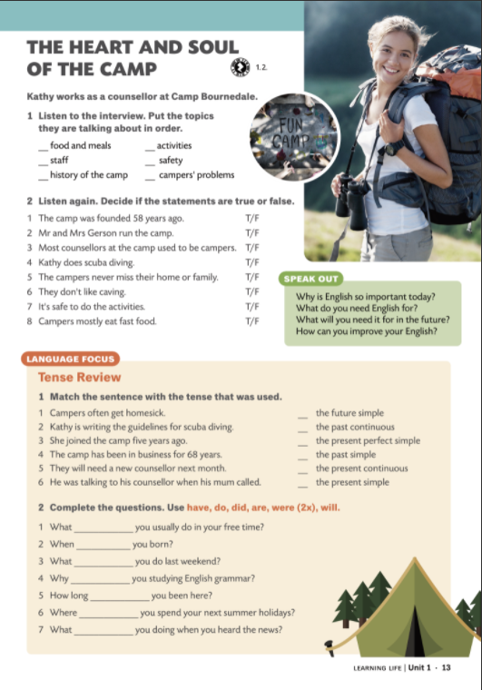

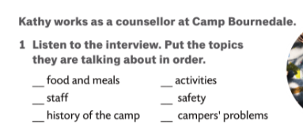
6
4
2
5
1
3

Slide 3
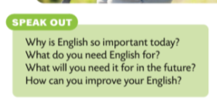
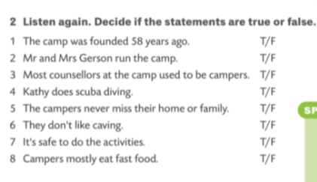

Slide 4
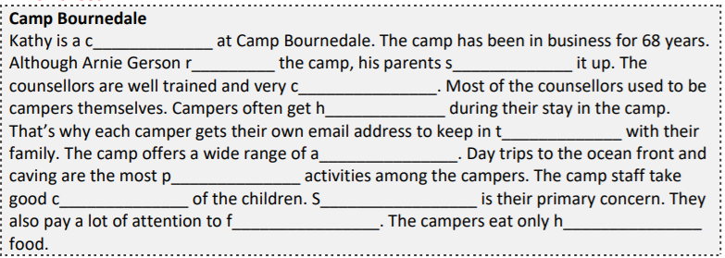
ounsellor
uns
tarted
ompetent
omesick
ouch
ctivities
opular
are
afety
ood
ealthy

